Slide 1
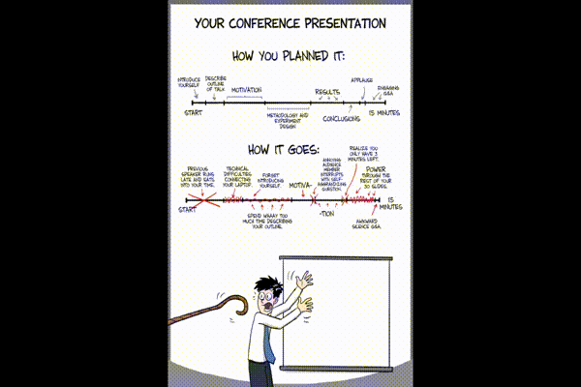
Paving the Path for Heterogeneous Memory Adoption in Production Systems
Neha Agarwal
Chair: Prof. Thomas Wenisch
Defense, Feb 20, 2017
Notes:
Hi Everyone, I am Neha and today I will talk how can we design simple but effective heterogeneous memory systems that can match the trends of upcoming applications.
Hi Everyone, I am Neha and today I will talk how can we design data management policies that can simplify the design of otherwise complex heterogeneous memory systems.

Slide 2

Heterogeneous memory systems
Found everywhere: supercomputers, data-centers, cloud-services
+
⇓
Notes:
We can find heterogeneous memory systems from fastest supercomputers to cloud services. For example, Titan a supercomputer built at Oak Ridge National Lab comprises of GPUs and Xeon Phis alongside of CPUs to accelerate High Perf Computing applications. Similarly, there is an emerging trend of deploying GPUs to accelerate machine learning applications in data-centers and cloud platforms. We find different memory technologies deployed in such systems showcasing heterogeneity in memory systems, which is the focus of my research.
But let’s first understand why build a heterogeneous system in the first place.

Slide 3
Why build heterogeneous systems?
Goal: increase performance per unit cost
Increase performance: accelerate applications ➤ less CPU time
Decrease cost: cost of ownership, programmers, design, verification
Applications are different in nature
Have different memory access patterns: streaming, random
Latency-sensitive, bandwidth-intensive
Match application to a computing platform / memory technology
Notes:
The main goal for designing a computing system is to maximize performance for every dollar spent. Increasing performance means that we want to run our applications faster than before. With specialized accelerators like throughput-oriented GPUs we have been able to cut down on computing time by orders of magnitude. Another parameter of our metric is cost, which can comprise of cost of owning and maintaining a computing facility, cost of hiring programmers, cost of designing and verifying a machine, which may not be directly quantifiable, but is a significant contributor to the overall cost. But, why not design a single machine to optimize for all these variables.
It turns out that all applications we want to run are not the same. Heterogeneity is a feature that applications exhibit in terms of different memory access patterns, some may be latency-sensitive like customer facing apps, or some can be bandwidth-sensitive instead for example data analytics crunching numbers out of a day long log of Uber rides.
So, in order to increase perf/dollar we need to match application nature with the available computing platforms or memory technologies or design new ones. The focus of my research is to exploit heterogeneity in main memory technologies to drive up perf/dollar of computing platforms.

Slide 4
Heterogeneity in memory technologies
Memory Type | Access latency | Bandwidth | Cost / bit
DDR | 1x | 1x | 1x
Graphics DDR | 1x | 2x-8x | 2x
3D XPoint (upcoming) | 5x-10x | x/2- x/4 | x/3 – x/5
Most servers/desktops have DDR main memory
Notes:
So, lets look at different memory technologies that exhibit different characteristics in terms of access latency, bandwidth, cost/bit etc. In this table, DDR technology is the most popular one that can be found in all our laptops, commonly referred as RAM or DRAM.

Slide 5
Heterogeneity in memory technologies
High bandwidth memory
Memory Type | Access latency | Bandwidth | Cost / bit
DDR | 1x | 1x | 1x
Graphics DDR | 1x | 2x-8x | 2x
3D XPoint (upcoming) | 5x-10x | x/2- x/4 | x/3 – x/5
2x - 8x
GPUs are massively parallel thus need lot of bandwidth, hence have high bandwidth memories
Notes:
In comparison to DDR technology we can see that the GDDR technology is a high bandwidth memory whose bandwidth can be as high as 8x of that DDRs. Turns out that high performance computing applications like fluid dynamics simulations etc. require tones of bandwidth to process different flows that can be done parallely. Thus, GDDR matches the requirement of massively parallel HPC applications, which otherwise if ran on a DDR enabled platform will be very slow.
Another technology that I want to discuss is upcoming cheaper memories from Intel/Micron’s 3D XPoint memory. This technology has a promise of being much cheaper than DRAM/DDR but slower than DRAM, which raises the question is it possible to replace DRAM some of the DRAM capacity with this cheaper technology and not suffer and performance degradation.
So the problem that we need to solve is to exploit the difference in these memory technologies to match with different types of applications we want to run.
Verify above numbers
Remove LPDDR numbers
Leaving capacity for now

Slide 6
Heterogeneity in memory technologies
Cheaper / slower memory
Memory Type | Access latency | Bandwidth | Cost / bit
DDR | 1x | 1x | 1x
Graphics DDR | 1x | 2x-8x | 2x
3D XPoint (upcoming) | 5x-10x | x/2- x/4 | x/3 – x/5
5x - 10x
x/3 - x/5
Intel’s/Micron’s 3D XPoint, Intel OPTANE
How to exploit characteristics of different memory technologies?
Notes:
Another technology that I want to discuss is upcoming cheaper memories from Intel/Micron’s 3D XPoint memory. This technology has a promise of being much cheaper than DRAM/DDR but slower than DRAM, which raises the question is it possible to replace some of the DRAM capacity with this cheaper technology and cut down on memory cost in large scale systems.
So the problem that we need to solve is to exploit the difference in these memory technologies to match with different types of applications we want to run.
Verify above numbers

Slide 7
Examples of heterogeneous systems
CPU
CPU-GPU Link
GPU
CPU
DDR4
DDR4
DDR4
DDR4
DDR4
DDR4
DDR4
DDR4
DDR4
DDR4
DDR4
CPU
memory
Fast
memory
DDR4
Unified Memory
Slow
memory
Graphics
memory
DDR technology
GDDR technology
(higher bandwidth)
DDR technology
3D XPoint technology
(cheaper but slower)
Coral system (IBM cpu, NVIDIA gpu)
https://www.olcf.ornl.gov/summit/
Two-tiered memory system
Notes:
Now, lets look at two example heterogeneous memory systems. First lets look at CPU-GPU platform that IBM and NVIDIA are building together for the next fastest supercomputer.

Slide 8
Challenges
Match heterogeneous memories to application behavior
Optimize for latency / bandwidth / programmability
Design and verification of multi-vendor systems
Each vendor is incentivized to reveal very little of their IP
Debugging particularly difficult in multi-vendor collaborations
Increase perf/$ of large-scale system
Increasing memory capacity to match in-memory dataset applications
Notes:
Verification is a major factor in the total cost and time-to-market to ship a processor. CPU–GPU coherence increases verification overhead
significantly, since it requires a combined validation of the CPU and GPU designs. Debugging problems are particularly difficult in multi-vendor collaborations, because each vendor is incentivized to reveal as little of their intellectual property as possible to their counterparts to preserve market advantage.

Slide 9
PhD research
1. Maximize memory bandwidth for bandwidth-hungry GPU applications
“Page Placement Strategies for GPUs within Heterogeneous Memory Systems”, ASPLOS ’15
“Unlocking Bandwidth for GPUs in CC-NUMA systems”, HPCA ‘15
2. Simplify CPU-GPU cache coherence implementation for programmability
“Selective GPU Caches to Eliminate CPU-GPU HW Cache Coherence”, HPCA ’16
3. Reduce memory cost in data-centers, while satisfying perf. targets
“Thermostat: Application-transparent Page Management for Two-Tiered Main Memory”, ASPLOS ‘17

Slide 10
Outline
Bandwidth-asymmetric systems
Policies maximizing memory bandwidth for GPGPU applications
Selective GPU caching
Simplify CPU-GPU cache coherence implementation
Cheaper memory technologies
A case for deploying cheaper but slower memories to increase perf/$
- Covered in Proposal
Notes:
animate proposal

Slide 11
CPU-GPU heterogeneous systems
What is new with CPU-GPU heterogeneous systems?
CPU
CPU-GPU Link
GPU
CPU-GPU Link
Conventional: PCIe
Higher latency (1-10us)
Lower bandwidth (~16GB/s)
All GPU data is placed in graphics memory
DDR4
DDR4
Upcoming: NVLink
Lower latency (~100ns)
Higher bandwidth (80GB/s)
DDR4
CPU
memory
Graphics
memory
Unified Memory
DDR technology
GDDR technology (higher bandwidth)
GPU can access CPU memory at much higher BW & lower latency
Coral system (IBM cpu, NVIDIA gpu)
Notes:
NVLink is cache coherent
R1, R2, R3?

Slide 12
Why do GPUs care about bandwidth?
Better
Baseline
GPGPU apps are bandwidth-sensitive and latency-tolerant

Slide 13
Can we place GPU data in CPU memory?
CPU
GPU
CPU-GPU Link
Better
DDR4
DDR4
DDR4
CPU
memory
Graphics
memory
Baseline
Unified Memory
GPU data
Baseline: All GPU data is placed in Graphics memory
Incentive to place GPU data in CPU memory for more memory BW & capacity

Slide 14
Existing data placement policies
Non-uniform memory access (NUMA) policies in OS [numactl]
Local placement: optimizes for lowering data access latency
Interleave placement: distributes data equally among memory nodes
OS doesn’t have bandwidth differential information
For example: difference in BW of CPU and graphics memory (2x-8x)
Due to lack of information, OS cannot place data efficiently
Notes:
where existing? MAYBE CITATIONS

Slide 15
Contribution: BW-AWARE placement
[Agarwal ASPLOS’15]
Place data in the ratio of the memory bandwidths
Utilize bandwidth of all the available memory zones
CPU
GPU
BW: 1x
BW: 1x
BW: 2.5x
DDR4
DDR4
DDR4
CPU
memory
Graphics
memory
100%
Local (Baseline)
50%
50%
Interleave (Baseline)
30%
70%
BW-AWARE
BW-AWARE placement maximizes BW hence increases GPU throughput
Notes:
The main contribution of this work is how we implement this idea by correlating

Slide 16
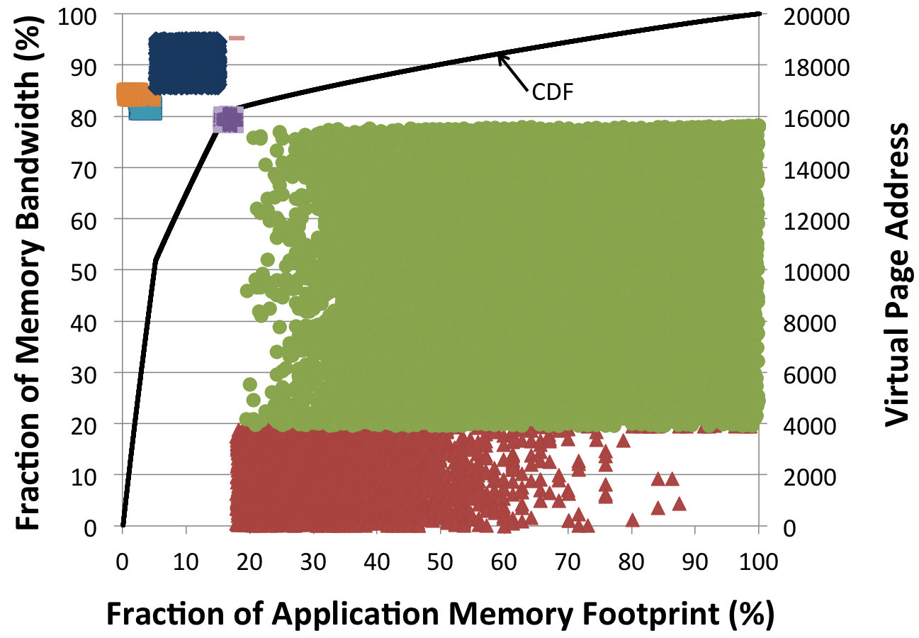
Implementation challenge: BW-AWARE
Ideal CPU-GPU access ratio: 30-70, but capacity ratio ~ 8-1
Prior knowledge of page access frequency not available
Observation: hot pages are co-located in virtual address space
Different colors represent data structures in BFS
Place/migrate hot page to graphics memory until
access ratio hits bandwidth ratio of 30-70
[Agarwal ASPLOS’15,
Agarwal HPCA’15]

Slide 17
BW-AWARE placement increases GPU throughput
[Agarwal ASPLOS’15]
Place data in the ratio of the memory bandwidths
Utilize bandwidth of all the available memory zones
CPU
GPU
Average across General Purpose GPU Apps
BW: 1x
BW: 1x
BW: 2.5x
DDR4
Better
DDR4
DDR4
CPU
memory
Graphics
memory
100%
Local
50%
50%
Interleave
30%
70%
BW-AWARE
BW-AWARE placement maximizes BW hence increases GPU throughput
Notes:
The main contribution of this work is how we implement this idea by correlating

Slide 18
Outline
Bandwidth-asymmetric systems
Policies maximizing memory bandwidth for GPGPU applications
Selective GPU Caching
Simplify CPU-GPU cache coherence implementation
Cheaper memory technologies
A case for deploying cheaper but slower memories to increase perf/$
- Covered in Proposal

Slide 19
Cache coherence in CPU-GPU systems
CPUs support HW cache coherence, why not CPU-GPU systems?
Pros:
+ Improves system programmability thus programmer productivity
+ Improves performance by fine-grained GPU access to CPU memory
Cons:
Hard to design: merging different coherence protocols explodes state space
Hard to implement and verify, especially in a multi-vendor setup
Can we provide illusion of a cache-coherent CPU-GPU system?
Notes:
It’s well known that CPUs support cache coherence for making sure that shared data across different cores have either a single writer or multiple readers but not both simultaneously. It makes multi-core systems easier to program. In contrast, GPUs that were designed for graphics application acceleration do not support cache coherence as graphics applications do not have shared data. However, with wider adoption of GPUs for general purpose applications the question we need to revisit is the support for cache coherence. CPU designs have proven that cache coherence is highly desirable for programmability, however, supporting cache coherence in HW for a CPU-GPU heterogeneous system seems lucrative from programmers perspective can be really hard from designers point of view. Not only it is hard to to merge 2 different coherence domains, moreover the design and verification of a multi-vendor systems becomes extremely challenging when it comes to designing CPU-GPU HW cache coherence.

Slide 20
Contribution: Selective GPU Caching
[Agarwal HCPA’16]
Principle: GPU caches data only if CPU is not caching
GPU doesn’t cache data homed in CPU memory
GPU doesn’t cache data homed in Graphics memory, if CPU is caching it
Remote directory: tracks data cached by CPU homed in Graphics memory
Request coalescing using MSHRs
Micro-architectural enhancements
Client cache
Reduces GPU access traffic to CPU memory
Variable-size link transfers
Improve CPU-GPU interconnect efficiency
u
v
CPU
GPU
v
CPU-GPU Link
Request
coalescer
w
Variable-size transfer
Remote directory
u
Client cache
x
w
DDR4
x
DDR4
DDR4
CPU
memory
Graphics
memory
Unified Memory
Un-cacheable

Slide 21
Contribution: Selective GPU Caching
[Agarwal HCPA’16]
Principle: GPU caches data only if CPU is not caching
Average across General Purpose GPU Application
HW cache coherence
✔High Performance
❌High design complexity
Selective GPU caching
✔ Good performance
✔ Low design complexity
Better
CPU and GPU need not implement same cache coherence protocol

Slide 22
Summary: CPU-GPU heterogeneous systems
BW maximizing data management policies
Improve GPU throughput, thus reduce application runtime
Programmability with performance and design simplicity
Provide illusion of HW cache coherence with a simplified design
[Agarwal ASPLOS’15, HPCA’15]
[Agarwal HPCA’16]

Slide 23
Outline
Bandwidth-asymmetric systems
Policies maximizing memory bandwidth for GPGPU applications
Selective GPU Caching
Simplify CPU-GPU cache coherence implementation
Cheaper memory technologies
A case for deploying cheaper but slower memories to increase perf/$
- Covered in Proposal
Notes:
animate proposal

Slide 24
Trends of data-center/cloud apps
Map datasets in memory
Reduces data access latency ➤ performance benefit
Reduces CPU time to run app ➤ lower cost
Increased memory installed / machine
Memory is expensive, 30% of machine cost
3-10% of data-center total cost of ownership
High-memory cloud instances 2x-10x more expensive than standard

Slide 25
Cheaper memory technologies to the rescue
Memory Technology | Access latency | Bandwidth | Cost / bit | Energy / bit
DDR | 1x | 1x | 1x | 1x
Cheaper/slower memory (upcoming) | 5x-10x | x/2- x/4 | x/3 – x/5 | x/2 – x/4
CPU
50-100ns
DDR4
DDR4
DDR4
DDR
Notes:
Both the frequently accessed data, let’s call it hot and infrequently accessed data, let’s call it cold is mapped in DRAM.

Slide 26
Cheaper memory technologies to the rescue
Memory Technology | Access latency | Bandwidth | Cost / bit | Energy / bit
DDR | 1x | 1x | 1x | 1x
Cheaper/slower memory (upcoming) | 5x-10x | x/2- x/4 | x/3 – x/5 | x/2 – x/4
CPU
CPU
Future
50-100ns
50-100ns
10x slower than DDR
DDR4
DDR4
DDR4
hot data (frequently accessed)
DDR
XPoint
DDR4
DDR
cold data (infrequently accessed)
Fast memory
Cheaper/slower memory
Mapping cold data to slow memory will free DRAM for other apps
Notes:
I want to emphasize the point that all data cannot be mapped to slow memory because of slowdown as that will overshadow memory savings by the requirement of provisioning entirely new machines.
However, with cheaper slower memory we can leverage the difference between data access frequency and place hot pages in fast DRAM and cold pages in cheaper/slower memory. Thus, there is an opportunity to cut down the DRAM requirement per application. Note that we only want to place those pages in slow memory that will not degrade application performance leading to SLA violations.

Slide 27
Prior proposals: 2-tier memory
Application guided two-tier memory [Dulloor EuroSys’16]
HW-managed two-tier memory [Qureshi MICRO’09, Sim MICRO’12]
SW-managed two-tier memory [Ekman IPDPS’05, Lim HPCA’12, AutoNUMA]
Drawbacks:
Not application-transparent, app source code may not be available
HW managed proposals treat DRAM as a cache, waste capacity
Only consider 4KB pages (huge pages critical to cloud apps)
Application slowdown not controlled, needed for cost savings
Notes:
Why huge pages break their solution:
Whether we have hot cold huge pages, no one has even asked that question
whether method for classification: low overhead
Profiling technique to identify data to be placed in slow memory
On-demand page migration from slow to fast memory
DRAM as a cache, invisible to OS

Slide 28
Prior proposals: 2-tier memory
Application guided two-tier memory [Dulloor EuroSys’16]
HW-managed two-tier memory [Qureshi MICRO’09, Sim MICRO’12]
SW-managed two-tier memory [Ekman IPDPS’05, Lim HPCA’12, AutoNUMA]
Drawbacks:
Not application-transparent, app source code may not be available
HW managed proposals treat DRAM as a cache, waste capacity
Only consider 4KB pages (huge pages critical to cloud apps)
Application slowdown not controlled, needed for cost savings
Notes:
Why huge pages break their solution:
Whether we have hot cold huge pages, no one has even asked that question
whether method for classification: low overhead
Profiling technique to identify data to be placed in slow memory
On-demand page migration from slow to fast memory
DRAM as a cache, invisible to OS

Slide 29
Prior proposals: 2-tier memory
Application guided two-tier memory [Dulloor EuroSys’16]
HW-managed two-tier memory [Qureshi MICRO’09, Sim MICRO’12]
SW-managed two-tier memory [Ekman IPDPS’05, Lim HPCA’12, AutoNUMA]
Drawbacks:
Not application-transparent, app source code may not be available
HW managed proposals treat DRAM as a cache, waste capacity
Only consider 4KB pages (huge pages critical to cloud apps)
Application slowdown not controlled, needed for cost savings
Notes:
Why huge pages break their solution:
Whether we have hot cold huge pages, no one has even asked that question
whether method for classification: low overhead
Profiling technique to identify data to be placed in slow memory
On-demand page migration from slow to fast memory
DRAM as a cache, invisible to OS

Slide 30
Prior proposals: 2-tier memory
Application guided two-tier memory [Dulloor EuroSys’16]
HW-managed two-tier memory [Qureshi MICRO’09, Sim MICRO’12]
SW-managed two-tier memory [Ekman IPDPS’05, Lim HPCA’12, AutoNUMA]
Drawbacks:
Not application-transparent, app source code may not be available
HW managed proposals treat DRAM as a cache, waste capacity
Only consider 4KB pages (huge pages critical to cloud apps)
Application slowdown not controlled, needed for cost savings
Notes:
Why huge pages break their solution:
Whether we have hot cold huge pages, no one has even asked that question
whether method for classification: low overhead
Profiling technique to identify data to be placed in slow memory
On-demand page migration from slow to fast memory
DRAM as a cache, invisible to OS

Slide 31
Huge pages: critical to cloud apps
Regular OS page size: 4KB, huge pages size: 2MB (Intel x86)
Advantages
u Fewer TLB misses
0
0
4KB
Reachable
by TLB
2MB
8KB
12KB
Reachable
by TLB
4MB
16KB
TLB
(caches PTEs)
...
Out of
TLB reach
8MB
8MB
Application on regular pages
Application on huge pages

Slide 32
Huge pages: critical to cloud apps
Regular OS page size: 4KB, huge pages size: 2MB (Intel x86)
Virtual page address
Advantages
1GB pages
2MB pages
4KB pages
Data
u Fewer TLB misses
CR3
3
1
5
Faster TLB misses
Fewer PTEs to cache
...
...
...
4
...
2
...
5 (4KB) ➤ 4 (2MB) memory accesses

Slide 33
Huge pages: critical to cloud apps
Regular OS page size: 4KB, huge pages size: 2MB (Intel x86)
Virtual page address
Advantages
1GB pages
2MB pages
4KB pages
Data
u Fewer TLB misses
3
1
5
Faster TLB misses
Fewer PTEs to cache
5 (4KB) ➤ 4 (2MB)
...
...
...
4
...
2
...
gCR3
Nested walk
Nested walk
Nested walk
Nested walk
Nested walk
x5
x5
x5
x5
x5
=25
x4
x4
x4
x4
=16
Host physical address
Guest physical address
25 (4KB) ➤ 16 (2MB): virtualization

Slide 34
Huge pages: critical to cloud apps
Regular OS page size: 4KB, huge pages size: 2MB (Intel x86)
Advantages
u Fewer TLB misses
Faster TLB misses
Fewer PTEs to cache
5 (4KB) ➤ 4 (2MB)
25 (4KB) ➤ 16 (2MB): virtualization
2MB Throughput Relative to 4KB (%)
Performance benefit up to 30% under virtualization
Notes:
We have both regular and huge pages in this system.

Slide 35
Prior proposals: 2-tier memory
Application guided two-tier memory [Dulloor EuroSys’16]
HW-managed two-tier memory [Qureshi MICRO’09, Sim MICRO’12]
SW-managed two-tier memory [Ekman IPDPS’05, Lim HPCA’12, AutoNUMA]
Drawbacks:
Not application-transparent, app source code may not be available
HW managed proposals treat DRAM as a cache, waste capacity
Only consider 4KB pages (huge pages critical to cloud apps)
Application slowdown not controlled, needed for cost savings
On-demand paging incurs large copying overheads with huge pages
Notes:
Why huge pages break their solution:
Whether we have hot cold huge pages, no one has even asked that question
whether method for classification: low overhead
Profiling technique to identify data to be placed in slow memory
On-demand page migration from slow to fast memory
DRAM as a cache, invisible to OS

Slide 36
Prior proposals: 2-tier memory
Application guided two-tier memory [Dulloor EuroSys’16]
HW-managed two-tier memory [Qureshi MICRO’09, Sim MICRO’12]
SW-managed two-tier memory [Ekman IPDPS’05, Lim HPCA’12, AutoNUMA]
Drawbacks:
Not application-transparent, app source code may not be available
HW managed proposals treat DRAM as a cache, waste capacity
Only consider 4KB pages (huge pages critical to cloud apps)
Application slowdown not controlled, needed for cost savings
Notes:
Why huge pages break their solution:
Whether we have hot cold huge pages, no one has even asked that question
whether method for classification: low overhead
Profiling technique to identify data to be placed in slow memory
On-demand page migration from slow to fast memory
DRAM as a cache, invisible to OS

Slide 37
How much slowdown is tolerable?
Replacing all DRAM with slow memory lowers overall cost by 3-10%
Perf slowdown → need to provision extra servers to maintain same level of overall throughput
Hence, can only tolerate 3-10% slowdown
Else cost of extra servers will overshoot cost savings
Cost of provisioning extra servers
Cost
Maximum possible cost savings from cheaper memory
Break-even point for cost, maximum possible slowdown
0
Slowdown
Net cost savings
Tolerable slowdown, very tight budget

Slide 38
Challenges to controlling slowdown
Low-overhead cold page detection mechanism
Support for huge pages
Application-transparent mechanism
Precise page access rate information to control app slowdown
Mapping cold data to slow memory results in throughput degradation
Notes:
Low overhead mechanism that identifies cold data at runtime
Application transparent manner
while supporting huge pages
while satisfying perf. requirements
I will present my solution to this problem that we call Thermostat, which we prototyped in Linux 4.5

Slide 39
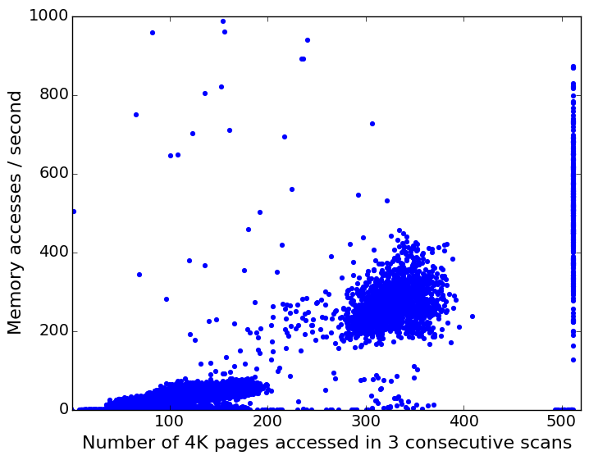
Prior cold page detection
HW “Accessed” bit based [Waldspurger OSDI‘02] [Zhou ASPLOS’04] [Lespinasse ‘11] [Guo VEE’15]
Estimate idle/cold pages in a given interval by scanning “Accessed” bit
Each dot represents a 2MB page in Redis
High page access rate, all 512 “accessed” bits are set
Memory accesses / second
Low page access rate, all 512 “accessed” bits are set
Number of “Accessed” bits set per 2MB page
Scan interval 10 sec
Notes:
How is accessed bit cleared? Or how is the mechanism works in general?

Slide 40
Prior cold page detection
HW “Accessed” bit based [Waldspurger OSDI‘02] [Zhou ASPLOS’04] [Lespinasse ‘11] [Guo VEE’15]
Estimate idle/cold pages in a given interval by scanning “Accessed” bit
Each dot represents a 2MB page in Redis
Better
Memory accesses / second
Tolerable slowdown 3%
Number of “Accessed” bits set per 2MB page
Scan interval 10 sec
“Accessed” bit cannot estimate page access rate with low-overhead
Notes:
How is accessed bit cleared? Or how is the mechanism works in general?

Slide 41
Contribution: Thermostat Application-transparent Page Management for Two-tiered Main Memory
[Agarwal ASPLOS’17]
Estimate page access rate using s/w induced fault mechanism
Cold page detection overhead (< 1%)
Controlled application slowdown to realize cost savings
Move cold pages to slow memory controlling slow mem. access rate
Input parameter: slowdown application can tolerate

Slide 42
Page access rate counting
fault_handler() {
...
access_count[page]++;
...
}
Application accessing poisoned page raises software fault
Linux fault handler is instrumented to keep track of how many times a page is accessed
Per page counter, incremented whenever this fault handler is invoked
However, too slow for counting accesses to every single page in the app
Sample pages for lowering overhead due to page access counting
Notes:
Explain poisoning here

Slide 43
Page sampling To keep page access counting overhead low
Application huge pages
2M
2M
...
2M

Slide 44
Page sampling To keep page access counting overhead low
Application huge pages
2M
2M
...
2M
Sampled
Continuously sample a random fraction of huge pages

Slide 45
Page sampling To keep page access counting overhead low
Application huge pages
2M
2M
Split
4K
4K
4K
4K
...
4K
...
2M
Sampled
Continuously sample a random fraction of huge pages
Split the sampled huge page into 4KB pages

Slide 46
Page sampling To keep page access counting overhead low
Application huge pages
2M
2M
Split
4K
4K
4K
4K
...
4K
...
2M
Sampled
Accessed
Continuously sample a random fraction of huge pages
Split the sampled huge page into 4KB pages
Only sample 4K pages for which hardware Accessed bit is set

Slide 47
Page sampling To keep page access counting overhead low
Application huge pages
2M
2M
Split
4K
4K
4K
4K
...
4K
Poison
4K
4K
4K
4K
4K
...
4K
Merge
2M
...
2M
Sampled
Accessed
Poisoned
Continuously sample a random fraction of huge pages
Split the sampled huge page into 4KB pages
Only sample 4K pages for which hardware Accessed bit is set
Record accesses to a few 4KB pages using s/w induced fault
Merge the split page back to huge page

Slide 48
How cold is “cold”?
0s
1s
1.03s
Time
30,000 accesses
…
…
Extra time per sec
3% slowdown in app ⇒ 30K accesses/sec from slow memory of 1us latency
1us/access
Pages below 30K cumulative accesses/second are “cold”
Notes:
COMA and many of the ideas that came to fruition in the 90's in the context of shared memory machines. COMA machines and even optimized CC-NUMA machines (e.g., Excel-NUMA) were exploring capacity and latency trade offs in multiple block-based cache hierarchy levels. You may find ideas that were developed and even built in machines (e.g., KSR and Sun WildFire/Reactive NUMA) of importance and inspiration. All of these address multi-level cache/DRAM hierarchies.

Slide 49
Page classification
For tolerable slowdown 3%, 1us slow memory latency, slow mem access rate = 3%/1us = 30k/sec
Pages in Fast Mem
Pages in Slow Mem
2M
2M
...
2M

Slide 50
Page classification
For tolerable slowdown 3%, 1us slow memory latency, slow mem access rate = 3%/1us = 30k/sec
Estimate huge page access rate by poisoned 4K pages
Pages in Fast Mem
Pages in Slow Mem
2M
2M
Sort by access frequency
...
2M

Slide 51
Page classification
For tolerable slowdown 3%, 1us slow memory latency, slow mem access rate = 3%/1us = 30k/sec
Estimate huge page access rate by poisoned 4K pages
Pages in Fast Mem
Pages in Slow Mem
2M
2M
Sort by access frequency
...
30k/sec,
scaled by sampling fraction
2M
Migrate to slow mem

Slide 52
Phase change detection
Pages behavior may change over time
Measure access rate to all cold pages & sort by access frequency
Pages above 30K total access rate get migrated back to DRAM
Pages in Fast Mem
Pages in Slow Mem
2M
2M
2M
2M
Sort by access frequency
...
...
2M

Slide 53
Phase change detection
Pages behavior may change over time
Measure access rate to all cold pages & sort by access frequency
Pages above 30K total access rate get migrated back to DRAM
Pages in Fast Mem
Pages in Slow Mem
2M
2M
Migrate back to DRAM
30k/sec
2M
2M
Sort by access frequency
...
...
2M

Slide 54
Thermostat: example
Thermostat continuously samples pages to detect cold data at runtime

Slide 55
Evaluation platform
Prototyped in Linux 4.5
72-core (HT), Intel Xeon E5-2699 v3
Control groups: resource isolation of client and server threads
Tolerable slowdown 3%, sample 5% pages, scan period = 10 sec
Socket-1
Socket-2
Server inside VM
(kvm, 8 cores)
Client
QPI
256 GB
256 GB

Slide 56



Applications
TPC-C on MySQL
Online transaction processing (OLTP) benchmark
Write-intensive (new-order + payment ~ 85%), heavily uses page cache
Fulfill customer orders to supply products from a company, widely used app
Cassandra
NoSQL database, wide-column with variable number of fields per key
Heavily uses page cache, compacts SSTables data structure on disk
Netflix is one of the biggest users, AppScale, Wikimedia, Apple, and any more
Redis
In-memory key-value store, single-threaded
Github, Twitter, Pinterest, Snapchat, Yelp, and many more users

Slide 57
MySQL-TPCC
Dominated by write transactions
New order + payment: ~85%
Largest table in schema: LINEITEM
Read infrequently ⇒ cold data
Cold data from page cache
50% data in slow memory, 1.3% throughput degradation

Slide 58
Cassandra
Data stored in immutable SSTables
Cached as memtables in memory
SSTables grow with writes
Compacted at a fixed frequency
Read requests served by memtables
SSTables not accessed frequently
SSTables ⇒ cold data
30-50% data in slow memory, 2% throughput degradation

Slide 59
Redis
In-memory key-value store
Large hash table
Keys distributed uniformly per page
High-throughput database
Cold data detected is low
15% data in slow memory, 2% throughput degradation

Slide 60
Sensitivity to slowdown parameter
Fraction of cold data increases with higher tolerable slowdown

Slide 61
Summary: Thermostat
Manages huge pages in a two-tier memory system
Application-transparent, low overhead mechanism
Cost benefit of slow memory + perf benefit of huge pages
Prototyped in Linux 4.5
Can be turned on/off per application
Controls application slowdown
while placing cold data in slow memory

Slide 62
Thesis summary
CPU-GPU heterogeneous systems
BW maximizing data management policies
Improve GPU throughput, thus reduce application runtime
Programmability with performance and design simplicity
Provide illusion of HW cache coherence with a simplified design
A case for deploying cheaper/slower memories in cloud
Cost benefit of slow memories + perf. of huge pages
[Agarwal ASPLOS’15, HPCA’15]
[Agarwal HPCA’16]
[Agarwal ASPLOS’17]

Slide 65
Thesis committee

Slide 66
Collaborators

Slide 67
Paving the Path for Heterogeneous Memory Adoption in Production Systems
Neha Agarwal
Notes:
Hi Everyone, I am Neha and today I will present data management policies that can simplify the design of otherwise complex heterogeneous memory systems.

Slide 68
Existing cold page detection
HW “Accessed” bit based mechanisms [Waldspurger OSDI‘02], [Zhou ASPLOS’04], [Lespinasse ‘11], [Guo VEE’15]
Low-overhead, estimate relative page hotness by scanning “Accessed” bit
Intel x86 page table entries (simplified)
Physical address Accessed bit ...
1
A
A 1
B
1
B 1
C
v
E
TLB miss
u Accesses page E
D
...
w HW page walk
y
x
1
E 0
TLB
...
S 0
“Accessed” bit is read and cleared, and TLB is flushed at fixed intervals
Notes:
How is accessed bit cleared? Or how is the mechanism works in general?

Slide 69
Page access counting
SW based page poisoning to induce fake faults: ~1us
TLB misses correlates with LLC misses for cold pages

Slide 70
Page access counting
SW based page poisoning to induce fake faults: ~1us
TLB misses correlates with LLC misses for cold pages
poison bit
0
A
A
0
B
B
1
C
C
0
D
D
1
E
TLB
...
...
Page table entries

Slide 71
Page access counting
SW based page poisoning to induce fake faults: ~1us
TLB misses correlates with LLC misses for cold pages
poison bit
TLB miss
0
A
A
0
B
Application access page E
B
1
C
C
0
D
D
1
E
TLB
...
...
Page table entries

Slide 72
Page access counting
SW based page poisoning to induce fake faults: ~1us
TLB misses correlates with LLC misses for cold pages
poison bit
TLB miss
0
A
A
0
B
Application access page E
B
1
C
C
Fake fault handler:
1. Un-poison PTE
0
D
D
1
0
E
TLB
...
...
Page table entries

Slide 73
Page access counting
SW based page poisoning to induce fake faults: ~1us
TLB misses correlates with LLC misses for cold pages
poison bit
TLB miss
0
A
A
0
B
Application access page E
E
2
1
C
C
Fake fault handler:
1. Un-poison PTE
2. Install TLB entry
0
D
D
1
0
E
TLB
...
...
Page table entries

Slide 74
Page access counting
SW based page poisoning to induce fake faults: ~1us
TLB misses correlates with LLC misses for cold pages
poison bit
TLB miss
0
A
A
0
B
Application access page E
E
2
1
C
C
Fake fault handler:
1. Un-poison PTE
2. Install TLB entry
3. Re-poison PTE
0
D
D
3
1
E
TLB
...
...
BadgerTrap [Gandhi CAN’14]
Page table entries

Slide 75
Migration & slow memory accesses
Data Transfer (MB/sec) | Migration | False-classification
Aerospike | 13.3 | 9.2
Cassandra | 3.8 | 3.8
In-mem-analytics | 16 | 0.4
MySQL-TPCC | 6 | 1.8
Redis | 11.3 | 10
Web-search | 1.6 | 0.3
Migration/false classification rates below expected BW of future memories
Notes:
Give the expected number here?

Slide 76
Load generator
Notes:
load gen ?

Slide 77





Paving a path for simplifying CPU-GPU coherence
Neha Agarwal
University of Michigan
Thomas Wenisch
David Nellans
Eiman Ebrahimi
John Danskin
Steve Keckler
Notes:
Hi Everyone, I am Neha Agarwal from University of Michigan. And, today I am going to talk about my work on how can we simplify CPU-GPU cache coherence designs. I and my advisor Tom Wenisch did this work with our collaborators at NVIDIA. This work was pretty interesting as our focus was on simplifying the design as much as possible for making adoption of the idea in industry feasible.

Slide 78
Discrete CPU-GPU systems
CPUs and GPUs connected via cache-line granularity interconnect
GPU
CPU
Dedicated CPU-GPU Link
Cache-line granularity link
(e.g., NVIDIA’s NVLINK)
DDR4
DDR4
DDR4
DDR4
DDR4
DDR4
DDR4
DDR4
DDR4
Graphicsmemory
Unified Memory
CPU
memory
Is coherence support necessary over this link?
Notes:
CPU-GPU platforms have gained a lot of importance as of late, and multiple vendors are involved with building such systems
The most powerful GPUs today are built on a separate die due to thermal and die area constraints and have their own specialized memory systems. Moreover, such discrete CPU GPU systems come from different vendors precluding single-die integration
In the context of this work we’re focusing on such discrete CPUs and GPUs that are connected via a cache-line granularity dedicated CPU-GPU interconnect such as NVIDIA’s NVLINK
We are particularly interested in investigating whether it is necessary to support cache coherence over such a link?

Slide 79
Why CPU-GPU cache coherence?
Improves programmer productivity by eliminating manual data copying
Improves performance via fine-grained access to remote memory
GPU
CPU
Dedicated CPU-GPU Link
DDR4
DDR4
DDR4
DDR4
DDR4
DDR4
Page
DDR4
DDR4
DDR4
Graphicsmemory
CPU
memory
Unified Memory
Line
Goal: High performance coherent address space
Notes:
In the context of these discrete CPU-GPU systems, introducing unified shared CPU-GPU memory has multiple potential benefits and is a concept being adopted by multiple vendors. Consider a system where all of memory, whether it is attached to the CPU or the GPU is treated as a unified globally visible address space and either the CPU or GPU can make requests to any part of this memory.
Now this notion of unified memory has gained traction because it improves programmer productivity by eliminating explicit copying of data and manual memory management. Traditionally, when there was an access for example from the GPU to a page that was in CPU-attached memory, that page
would need to copied over to graphics memory.
We further improve programmer productivity and system performance by allowing fine grained access from the GPU to the CPU memory.
Our goal with this work is to provide a high performance shared virtual address space -- irrespective of the consistency model being assumed
Now by making all the caches in this system HW cache coherent can solve this design problem, however,

Slide 80
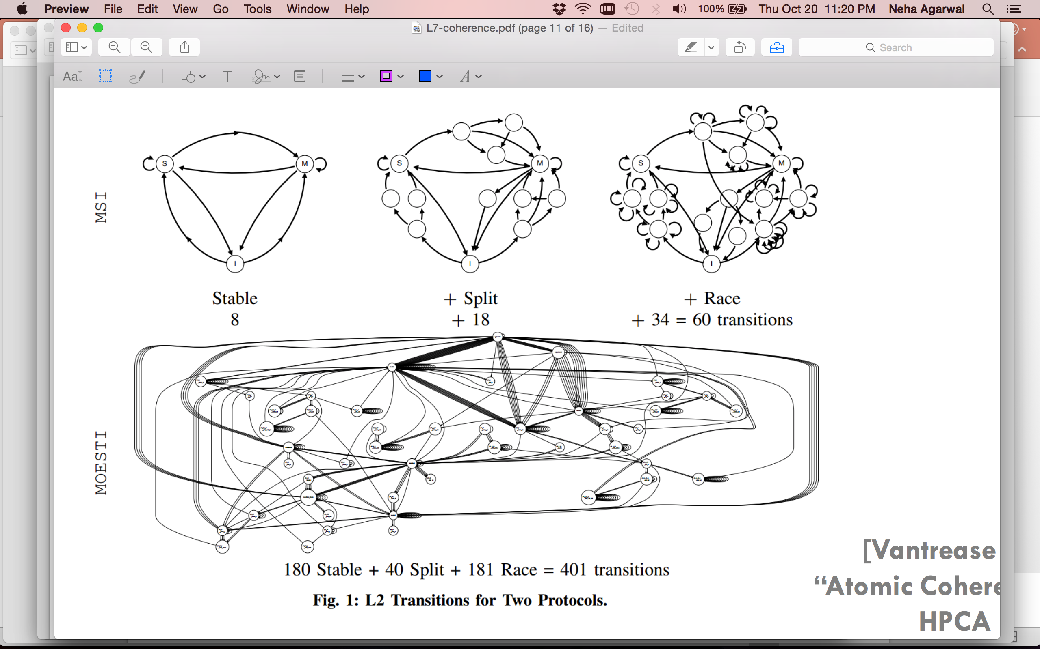
CPU-GPU HW cache coherence is DIFFICULT
1. Cache coherence state space explosion
Notes:
Now here is an example state space diagram for 2 different CPU cache coherence protocols combined to support all the states in both of the protocols. As we can look, this horrifying diagram has many states for the combined protocol to work correctly. Now imagine combining such complex cache coherence protocols from a CPU vendor and a GPU vendor. Its not difficult to see that such a cache coherent design will have large number of states calling for huge design and verification effort from the engineers.

Slide 81

CPU-GPU HW cache coherence is DIFFICULT
2. Vendor collaboration
Notes:
Since these discrete CPU GPU systems come from different vendor another challenge for these vendors is to come up with a design together.
Collaborating across different teams within the same company can be quiet challenging, but its another can of worms when designs have to be made to work correctly across companies. So, given how complex cache coherence design can get, our goal with this work was to simplify the design itself, thus cut down on the verification challenge and deliver the product timely.

Slide 82
Goal: Simplify CPU-GPU coherence design
1. Cache coherence state space explosion
Restrict GPU’s caching ability exploiting GPU’s latency tolerance
2. Vendor collaboration
CPU and GPU need not implement same coherence protocol
Solution: Selective GPU caching
Notes:
To address the problem of state space explosion our key idea is to restrict the GPU’s ability to cache data and exploit the GPU’s latency tolerance properties to have minimal effect on performance
And to address the challenge of vendor collaboration we want a solution that doesn't require CPU and GPU to implement same cache coherence protocol.
Our solution to address above challenges is Selective GPU caching with which we provide globally visible shared memory w/o HW cache coherence

Slide 83


Selective GPU Caching: Principles
1. CPU caches both CPU- & graphics-memory
2. GPU never caches CPU-memory
3. GPU caches graphics-memory
if CPU not caching
CPU
DDR4
DDR4
DDR4
CPU
memory
Directory
GPU
GDDR5
GDDR5
Remote Directory
GDDR5
GDDR5
GDDR5
GDDR5
GDDR5
Graphics
memory
CPU caching capability remains intact
GPU doesn’t need to handle coherence traffic from CPU
Notes:
Selective caching is based on these three principles:
CPU caches all of memory, the GPU never caches the CPU attached memory, and the GPU only caches GPU-memory only if CPU is not caching it.
Envision a simple system such as the one shown here. We’ve got one CPU and one GPU with DDR connected to the CPU, GDDR connected to the GPU and a dedicated link connecting the two…
The primary micro architectural structure needed to implement selective caching is a remote directory on the GPU side. This directory approximately but conservatively tracks the lines homed in GPU memory that are presently cached at the CPU.
Now if the GPU reads from an address mapped to DDR memory on the CPU side, the regular directory sends the most recent copy. If the GPU writes to DDR memory, the directory handles invalidation of CPU side caches. If the CPU reads/writes GDDR, then the line is inserted in the remote directory. The GPU uses this filter to figure out whether or not it can cache a given line. If a line is found in the filter, the GPU can’t cache it.
What I just described is a pretty primitive and naïve implementation of selective caching. We expect this level of naively bypassing GPU caches to result in some loss of performance compared to a fully cached solution.

Slide 84
Performance vs Design complexity trade-off
HW cache coherence
✔High Performance
❌High design complexity
Selective GPU caching
❌ Low performance
✔ Low design complexity
Uses link bandwidth inefficiently
Uses remote DRAM bandwidth
inefficiently
Misses out on bandwidth savings
from caching locality
How can we make Selective GPU Caching high performant?
Notes:
This graph shows the performance effect of a naïve implementation of selective caching as we described it on the previous slide normalized to a base line that has fully coherent CPU and GPU caches for different applications.
This graph shows that this loss of performance is on average greater than 50% and
Sometimes as large as 80-90% in the case of applications like btree and comd. To bridge this performance gap we came up with some micro architectural enhancements.

Slide 85

Performance enhancements to Selective Caching
1. Aggressive Request Coalescing
2. CPU-side client cache
3. Variable-size link transfers
v
CPUs
DDR4
Client Cache
DDR4
DDR4
Reduces CPU memory traffic from the GPU
Directory
CPU
memory
w
Variable-size Transfer
Improves CPU-GPU interconnect efficiency
GDDR5
GDDR5
GDDR5
GDDR5
GDDR5
u
GDDR5
Remote Directory
GDDR5
Request Coalescer
Graphicsmemory
Spatially coalesces GPU requests to CPU memory
GPU
Notes:
Here are three optimizations we have developed. I’ll go over each optimization and how it closes the gap in performance I just showed.

Slide 86
Performance enhancements to Selective Caching
1. Aggressive Request Coalescing
2. CPU-side client cache
3. Variable-size link transfers
v
CPUs
DDR4
Client Cache
DDR4
DDR4
Reduces CPU memory traffic from the GPU
Directory
CPU
memory
w
Variable-size Transfer
Improves CPU-GPU interconnect efficiency
GDDR5
GDDR5
GDDR5
GDDR5
GDDR5
u
GDDR5
Remote Directory
GDDR5
Request Coalescer
Graphicsmemory
Spatially coalesces GPU requests to CPU memory
GPU
Notes:
The first is to implement aggressive MSHR request coalescing for requests sent to CPU memory.

Slide 87
Request Coalescing: Captures spatial locality
Miss Status Holding Register (MSHR)
1
1
1
DDR4
128B req
DDR4
128B data
DDR4
CPU
memory
16B data
16B data
16B data
16B data
16B data
16B data
16B data
16B data
16B req
16B req
16B req
16B req
16B req
16B req
16B req
16B req
16B req
16B req
16B req
GPU
CPU
35% requests are coalesced≈ 80% of L1-hits
Notes:
With request coalescing we want to Reduce the number of requests made to CPU-memory from the GPU
We use miss status holding registers in GPU to track outstanding cache misses, however, remember we will not cache any data returned from the CPU memory.
For the sake of this example I’ll assume 16B requests showing up from the GPU.
To do this, we promote the granularity of individual load requests before issuing them to the DDR memory system. This means an individual load request, is promoted to 128B or the size of a cachline before being issued as a request
While this larger request is in flight, if other requests are made within the same 128B block, then these requests can simply be attached to the pending request list in the corresponding MSHR and no new requests are issued to the memory system.
Now to maintain correctness in a non-caching system any parts of the returning 128B block that haven’t been requested are going to be discarded immediately on arrival to the GPU.
It turns out there a good deal of spatial locality that can be captured this way. On average 35% of memory requests can be serviced via cacheless request coalescing. While this may seem like a low absolute number, we are capturing spatial locality and providing the majority of the benefit of L1 caches with a much lower overhead approach of simply coalescing at the MSHRs.

Slide 88
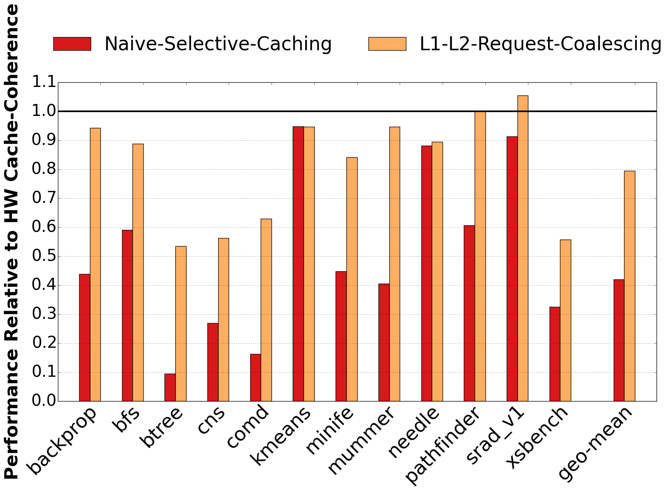
Request Coalescing: Performance
20%
Notes:
This graph shows how request coalescing affect performance compared to a naïve selective caching solution.
The request coalescing referred to as L1-L2 request coalescing simply means that its happening at both L1 and L2 cache levels.
We find that we can close the gap to within 20% the performance of full caching just by adding this first optimization on top of the described naïve selective caching implementation. However, although request coalescing exploits spatial locality, it does not capture temporal locality and there are other inefficiencies that we aim to address.

Slide 89
Performance enhancements to Selective Caching
1. Aggressive Request Coalescing
2. CPU-side client cache
3. Variable-size link transfers
v
CPUs
DDR4
Client Cache
DDR4
DDR4
Reduces CPU memory traffic from the GPU
Directory
CPU
memory
w
Variable-size Transfer
Improves CPU-GPU interconnect efficiency
GDDR5
GDDR5
GDDR5
GDDR5
GDDR5
u
GDDR5
Remote Directory
GDDR5
Request Coalescer
Graphicsmemory
Spatially coalesces GPU requests to CPU memory
GPU
Notes:
If request coalescing fails to capture re-use of a cache line, then over time multiple requests for the same line in CPU memory may be sent to the memory controller causing inefficiency in utilizing DDR by the GPU. To address this inefficiency, the second optimization we developed is a CPU-side GPU client cache.

Slide 90
CPU-side Client Cache: Capture temporal locality
Prevent requests for the same line in CPU-memory
Participate in CPU coherence protocol
Only allocate lines upon request of the GPU
GPU Data
GPU Req
GPU Data
GPU Req
Client Cache
GPU Data
DDR4
DDR4
DDR4
CPU
memory
GPU
CPU
Coherence traffic within CPU die only
Notes:
The key idea of this CPU side client cache is to shield the DDR memory system from repeated requests for the same line when request coalescing does not capture temporal reuse
This cache participates in the CPU coherence protocol like any other coherent cache on the CPU die
This single new cache does not introduce the coherence and interconnect scaling challenges of the GPU side caches while still providing latency and bandwidth filtering advantages for GPU requests.
Explain the animation.
This client cache thus captures temporal locality from the traffic generated by the GPU.
Note that this cache only allocates lines upon request by an off-chip processor such as the GPU. We put this client cache on the CPU side in order to not bring any coherency onto the GPU die.

Slide 91
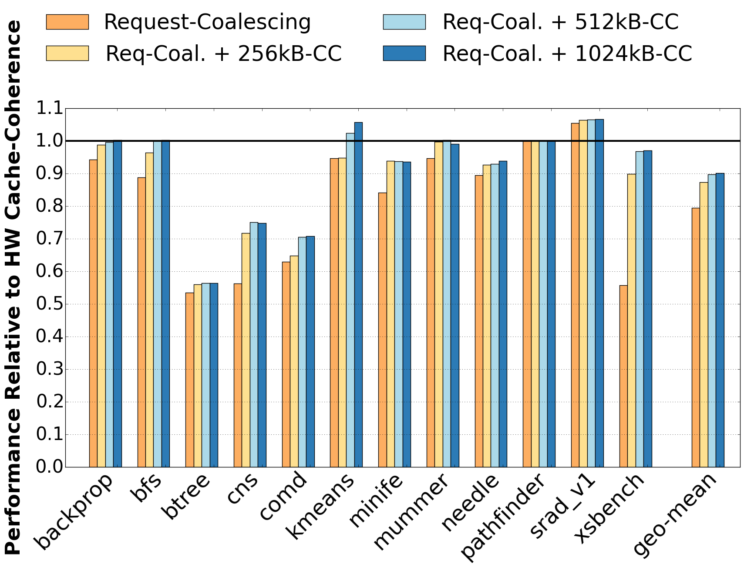
CPU-side Client Cache: Performance
10%
Notes:
This graph shows the performance impact of adding the CPU side client cache on top of the request coalescing described earlier. Here we show performance for client side of 256KB to 1MB. The performance improvements scale up with the size of this cache up till around a 512KB cache and then start to taper off. Combining such a 512KB 8-way associative client cache with request coalescing gets us to within 10% of the performance of a fully HW cache coherent CPU-GPU solution.

Slide 92
Performance enhancements to Selective Caching
1. Aggressive Request Coalescing
2. CPU-side client cache
3. Variable-size link transfers
v
CPUs
DDR4
Client Cache
DDR4
DDR4
Reduces CPU memory traffic from the GPU
Directory
CPU
memory
w
Variable-size Transfer
Improves CPU-GPU interconnect efficiency
GDDR5
GDDR5
GDDR5
GDDR5
GDDR5
u
GDDR5
Remote Directory
GDDR5
Request Coalescer
Graphicsmemory
Spatially coalesces GPU requests to CPU memory
GPU
Notes:
Our third optimization is variable-size link transfers over CPU GPU interconnect.

Slide 93
Data over-fetch across CPU-GPU interconnect
Miss Status Holding Register (MSHR)
1
1
1
DDR4
128B req
DDR4
128B data
DDR4
CPU
memory
16B data
16B data
16B data
16B data
16B data
16B data
16B data
16B data
16B req
16B req
16B req
16B req
16B req
16B req
16B req
16B req
16B req
16B req
16B req
GPU
CPU
40% of data is discarded without being consumed
Notes:
An average cacheline utilization of 60% indicates that just 77 out of 128 bytes transferred are actually used by the GPU.
So 40% of transferred bytes are immediately discarded without even being consumed.
We reduce the transfer unit from 128B down to 64B or 32B to improve the bandwidth utilization of CPU-GPU interconenct.
But then we need to deal with trade-offs associated with packetization overheads. If the data transfer unit is smaller then fixed size packet overhead can reduce the overall link utilization. For example, with 16B packet headers, if we fetch all data in 128B cache line then the link utilization is 88%, however link utilization reduces to 66% in case of 32B data transfer units.
So to maintain the benefit of request coalescing but reduce interconnect inefficiency we use variable transfer units on the CPU-GPU interconnect.

Slide 94
Variable size link transfers: Key Ideas
Miss Status Holding Register (MSHR)
1
1
1
1
1
DDR4
1
DDR4
128B req
DDR4
128B data
CPU
memory
16B req
16B req
16B req
16B req
16B req
16B req
16B req
16B req
16B req
16B data
16B data
16B data
16B req
16B req
GPU
CPU
Notes:
To enable the variable size link transfers, we embed a bit-mask in each request header indicating which sub-blocks of the 128B cache line should be transferred back. The
What happens here is that while an initial request is pending across the CPU-GPU interconnect, we merge any further sub-blocks with whatever the initial bit-mask indicated
Its worth noting here that variable size transfer units are also understood by the MSHRs of the CPU-side client cache that we talked about in the second optimization …By maintaining this mask when CPU memory returns a 128B cache line only the requested sub-blocks are returned to the GPU

Slide 95
Variable size link transfer: Impact on traffic
Notes:
This graph shows the impact of variable size transfer on the data transferred across the CPU-GPU interconnect.
For each benchmark the bars show relative transfer of data across the interconnect, you can see a significant drop on the amount of data transferred using the variable size transfer technique.
The big gain with this optimization is the significantly less amount of data transferred across the link which can enables power savings. Performance (which we don’t show in this graph) significantly improves for some benchmarks but on average the improvement is relatively smaller than the previous enhancements and we see a 3% performance improvement from this optimization.

Slide 96
Conclusion: Selective Caching
CPUs and GPUs do not need to be HW cache coherent to achieve the benefits of unified memory and high GPU performance
With request coalescing, a CPU-Side GPU client cache, and variable sized link transfer, we come within 7% of a HW cache coherent GPU
Promiscuous read-only caching benefits latency-sensitive applications using OS-page protection mechanisms

Slide 97
Selective GPU caching with HW changes
7%
Notes:
Pulling the results from all the optimizations together, this is what the summary looks like
If we normalize everything to a fully coherent solution
We see that a naïve selective caching solution loses a lot of performance
But adding the aggressive MSHR coalescing, the client cache, and variable transfer units get us to within 7% of a fully coherent system.

Slide 98
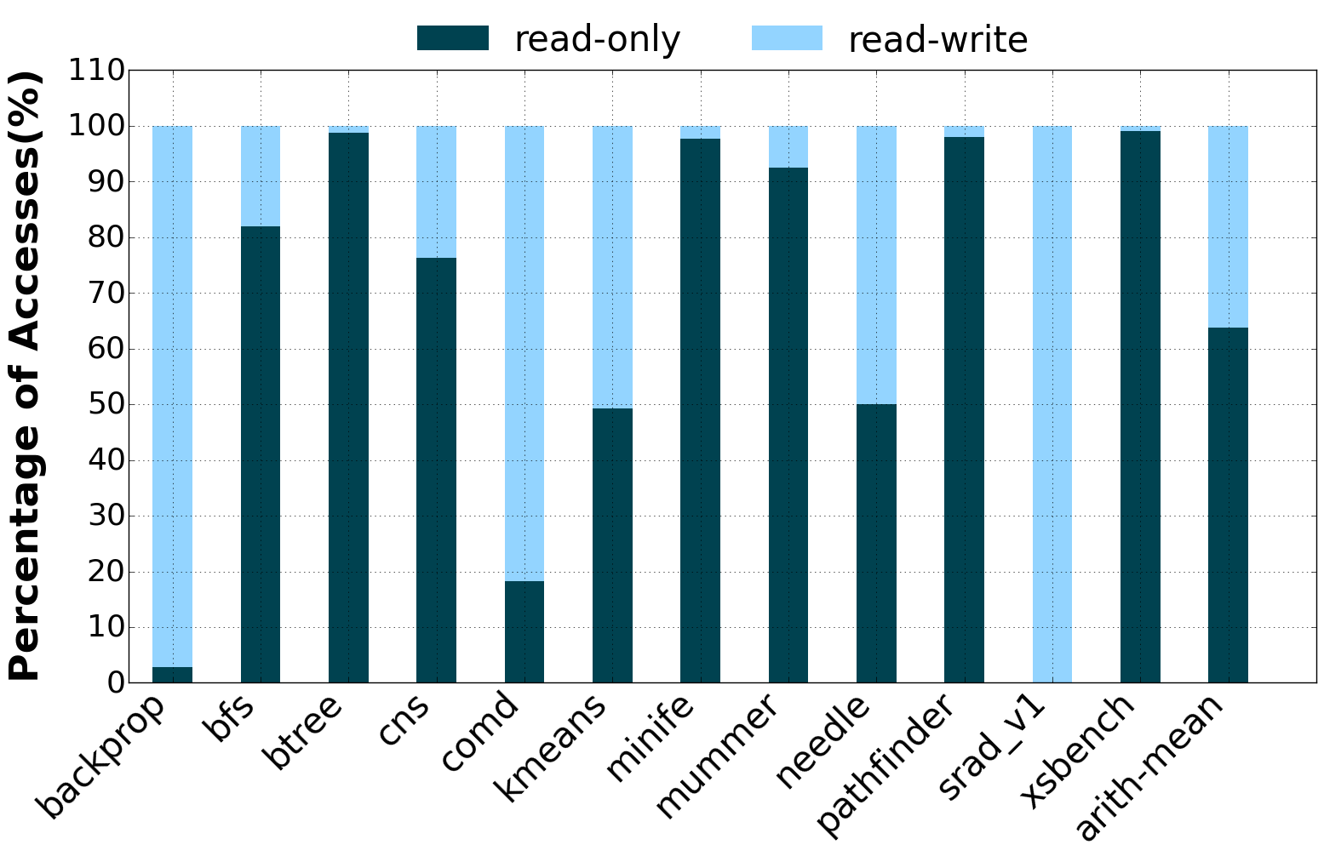
Does GPU have to avoid caching CPU memory?
60% of data is read-only
GPU could cache such read-only data safely
Notes:
Up until this point, I’ve described three mechanisms which are basically hardware optimizations and, they all assume the GPU strictly never caches any part of CPU memory. The question is, does the GPU have to avoid caching CPU memory all the time?
This graph shows the fraction of data touched by the GPU that is read only vs both read and written at an OS page granularity. We find that in many workloads the majority of data touched by the GPU is read-only at an OS page level.
In fact, 60% of the data is read-only. The idea here is that the GPU could potentially cache such read-only data safely, and we could guarantee correctness through OS page protection mechanisms entirely in software.

Slide 99
Promiscuous Read-only Caching: SW mechanism
Predict read-only pages
and allow GPU to cache them
Use software fault handler
to clean up mispredictions
Effectiveness determined by
prediction accuracy and miss-prediction penalty
Notes:
To this end, we investigate and propose promiscuous read only-caching. In this mechanism, both the CPU and the GPU can cache all of CPU memory with read-only page protection bits in page tables to guarantee correctness. Essentially, on a read to a page a prediction is made as to whether it’s a read-only page. If a write comes to such a page, a protection fault is raised, upon which the software fault handler flushes the corresponding lines from the GPU caches, and the write bit is set on the page table entry. The GPU inspects the page protection of each page before caching it, and if it is in a read-write state, does not cache it. This software mechanism ensures that coherence is maintained, while not penalizing caching accesses to read-only lines.
In the graph on the right, we can see that read-only caching performs at-par with hardware cache coherence.
Some workloads exhausting the GPUs ability to overlap execution with the faults. Hence, suffer considerable slowdowns due to exposed protection fault latency. For such workloads we can disable promiscuous read-only caching in the software. Nevertheless, this mechanism can gain performance by effectively caching a large fraction of read-only data present in many other GPU applications.

Slide 100
HW Selective Caching – all workloads
7%
Notes:
Pulling the results from all the optimizations together, this is what the summary looks like
If we normalize everything to a fully coherent solution
We see that a naïve selective caching solution loses a lot of performance
But adding the aggressive MSHR coalescing, the client cache, and variable transfer units get us to within 7% of a fully coherent system.

Slide 101
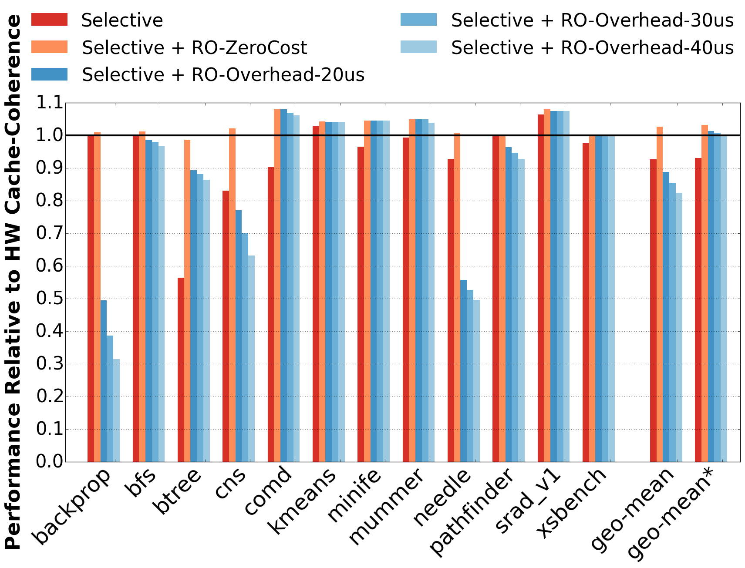
Promiscuous Read-only Caching
Predict read-only pages
and allow GPU to cache them
Use software fault handler
to clean up mispredictions
Effectiveness determined by
prediction accuracy and miss-prediction penalty
Notes:
To this end, we investigate and propose promiscuous read only-caching. In this mechanism, both the CPU and the GPU can cache all of CPU memory with read-only page protection bits in page tables to guarantee correctness. Essentially, on a read to a page a prediction is made as to whether it’s a read-only page. If a write comes to such a page, a protection fault is raised, upon which the software fault handler flushes the corresponding lines from the GPU caches, and the write bit is set on the page table entry. The GPU inspects the page protection of each page before caching it, and if it is in a read-write state, does not cache it. This software mechanism ensures that coherence is maintained, while not penalizing caching accesses to read-only lines.
In the graph on the right, we can see that read-only caching performs at-par with hardware cache coherence.
Workloads like backprop, cns, needle tend to issue many concurrent writes, exhausting the GPUs ability to overlap execution with the faults. Hence, suffer considerable slowdowns due to exposed protection fault latency. For such workloads we can disable promiscuous read-only caching in the software. Nevertheless, this mechanism can gain performance by effectively caching a large fraction of read-only data present in many other GPU applications.

Slide 102
Data Over-fetch across CPU-GPU interconnect
Workload | Avg. Cacheline Utilization (%)
backprop | 86
bfs | 37
btree | 79
cns | 78
comd | 33
kmeans | 25
minife | 92
mummer | 46
needle | 39
pathfinder | 87
srad_v1 | 96
xsbench | 30
Average | 60
Reduce transfer unit: 128B down to 64B or 32B?
Trade-offs with packetization overhead
We propose variable-size link transfers
Notes:
This table shows the amount of data over-fetch across our evaluated benchmarks. In this table cacheline utilization refers to the fraction of the transferred line that has a pending request when the GPU receives a cacheline-sized response from CPU memory. An average cacheline utilization of 60% indicates that just 77 out of 128 bytes transferred are actually used by the GPU.
So 40% of transferred bytes are immediately discarded
We might want to reduce the transfer unit from 128B down to 64B or 32B to improve this
But then we need to deal with trade-offs with packetization overheads. Assuming all data is used (which isn’t the case obviously), but if all the data in what is returned were used at 32B granularity we’d at best have 66% link utilization, but at 128B granularity we’d have 88% link utilization.
So to maintain the benefit of request coalescing but reduce interconnect inefficiency we propose using variable transfer units on the CPU-GPU interconnect.

Slide 103
Problem!
20+
Cores
(CPU)
20+
Cores
(CPU)
change diagram
Cache-coherent Link
CPU-GPU Link
CPU-GPU Link
100+ SMs
(GPU)
100+ SMs
(GPU)
Future: Hundreds of coherent caches?
Hard to implement in a timely manner
Notes:
The problem is…
But when we start adding GPUs, GPUs are expected to have up to hundreds of streaming SMs each with their own cache, trying to extend traditional cache coherency into the GPU memory system requires keeping hundreds of caches coherent. And its fairly well known that scaling cache coherence to this degree is pretty difficult and requires both very large state and very large interconnect bandwidth. This makes it fairly unattractive to build fully cache coherent systems using this approach.
This proves even more difficult with multiple vendors trying to integrate existing CPU and GPU designs in a timely manner.

Slide 104
CPU-GPU heterogeneous systems
Simplifying CPU-GPU coherence [HPCA’16]
CPU and GPU need not implement same cache coherence protocol
Simplifies vendor collaboration

Slide 105
Discrete CPU-GPUs
Simplifying CPU-GPU coherence [HPCA’16]
CPU and GPU need not implement same cache coherence protocol
Simplifies vendor collaboration
BW-aware page placement & migration [ASPLOS’15] [HPCA’15]
Maximizes b/w available to GPU by optimal page placement
Intelligent page prefetch when all data starts off in CPU memory

Slide 106

Heterogeneous Memory Systems
Can be found everywhere

Slide 107
Why build heterogeneous memory systems?
2 issues:
with variation in application patterns we cannot use one memory technology for all applications
Talk about BW hungry GPU apps
so, we have high bandwidth memories for GPUs
but we also have CPU attached memory
so, what is the optimal way to utilize both of these memory zones
Memory capacity / machine increasing, but memory is expensive (30% of machine cost), lots of money, memory management of increased memory size/machine is challenging
Match memory access patterns, reduce CPU time, save cost

Slide 108
Cold data in applications with huge pages
Detection by scanning hardware ‘Accessed’ bit in PTE at 10s interval
Mechanisms built on ‘accessed’ bit cannot provide perf. guarantees
Notes:
But if we start detecting cold pages at 2MB granularity the amount of cold data detected is much less. It’s because of the way current OS level cold page detection mechanisms work. They only operate at page granularity. So, when a 2MB page is used, even pounding on a single byte out of that 2MB region will classify the complete 2MB region as hot. Although 99% of the bytes are cold and could have been potentially mapped to slow memory. Therefore, we have a problem in detecting true cold pages at 2MB granularity.

Slide 109
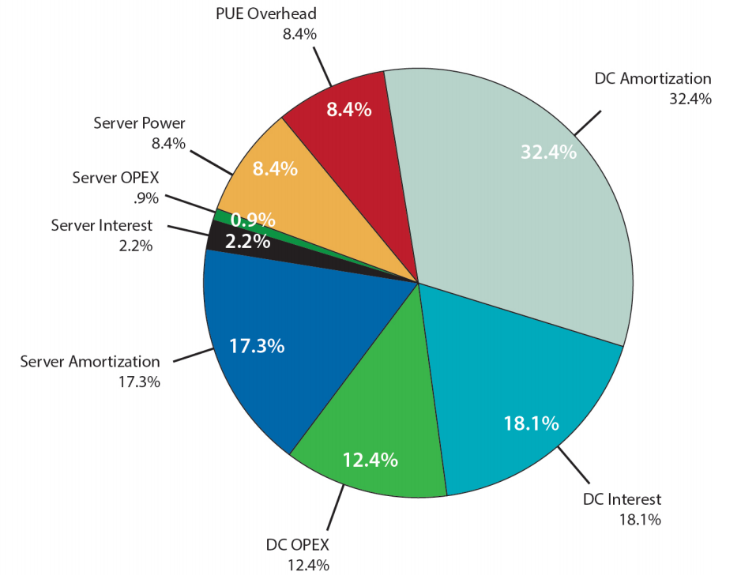
How much slowdown is tolerable?
Server CapEx ~ 17%
If slow memory is 1/3 as cheap as DRAM, overall cost saved ~ 3%
Less perf ➔ more servers, slowdown of x% ➔ x% higher TCO
Can only have at most 3% slowdown
Source: The Datacenter as a Computer: An Introduction to the Design of Warehouse-Scale Machines, Second Edition, Luiz André Barroso, Jimmy Clidaras, Urs Hölzle, 50% occupied datacenter scenario, pp. 97
Notes:
But how much slowdown can we actually tolerate without increasing the overall cost of deployment. On the right we have a pie chart of TCO distribution for a 50% occupied data center. We see that capital expenditure is 17% of the overall cost. So, if slow memory is 1/3 as cheap as DRAM then overall cost saved will be 3% assuming memory cost is 30% of the machine cost. But less performance means more servers to maintain same level of throughput. Therefore, we can have at most 3% slowdown in order to reduce total cost of ownership.

Slide 110
Thesis statement
Study memory characteristics beyond memory access latency
Goals:
Simplify system design
Ease programmability (application-transparent policies)
Increase performance / unit cost
Efforts driven towards adoption in production systems

Slide 111
Different memory technologies
Memory Technology ↓ | Access latency | Bandwidth | Cost / bit | Energy / bit
DDR | 1x | 1x | 1x | 1x
GDDR / HBM | 1x | 2-8x | 2x | 2x
3D XPoint | 4-10x | x/2- x/4 | x/3 – x/5 | x/2 – x/4
LPDDR | 1x | 1x | x/4 | x/2
Notes:
Leaving capacity for now

Slide 112
Different memory technologies
High bandwidth memory
Memory Technology ↓ | Access latency | Bandwidth | Cost / bit | Energy / bit
DDR | 1x | 1x | 1x | 1x
GDDR / HBM | 1x | 2-8x | 2x | 2x
3D XPoint | 4-10x | x/2- x/4 | x/3 – x/5 | x/2 – x/4
LPDDR | 1x | 1x | x/4 | x/2
2-8x
4-10x
x/2 – x/5
x/2
Cheaper slower memory
Low power memory
How to exploit characteristics of different memory technologies?
Notes:
Verify above numbers
Remove LPDDR numbers
Leaving capacity for now

Slide 113
My proposal: BW-AWARE placement
Place data in the ratio of the memory bandwidths
Utilize bandwidth of all the available memory zones
Graphics : CPU memory BW ratio: 2.5 : 1
Higher is better
BW-AWARE placement maximizes BW hence the GPU throughput
Notes:
Proposal??

Slide 114
My proposal: BW-AWARE placement
Place data in the ratio of the memory bandwidths
Utilize bandwidth of all the available memory zones
CPU
Dedicated CPU-GPU Link
GPU
BW: 1x
BW: 1x
BW: 2.5x
Higher is better
DDR4
DDR4
DDR4
DDR4
DDR4
DDR4
DDR4
DDR4
CPU
memory
DDR4
Unified Memory
Graphics memory
30% data here
70% data here
Graphics : CPU memory BW ratio: 2.5 : 1
BW-AWARE placement maximizes BW hence the GPU throughput
Notes:
Proposal??

Slide 115
My proposal: Selective GPU caching
GPU caches only if CPU is not caching, GPU is latency tolerant
CPU and GPU cache coherence protocols need not be the same
Average across General Purpose GPU Application
HW cache coherence
✔High Performance
❌High design complexity
Selective GPU caching
✔ High performance
✔ Low design complexity
Higher is better
With SW protection, performance at par with HW cache coherence

Slide 116
My proposal: Selective GPU caching
GPU caches only if CPU is not caching, GPU is latency tolerant
CPU and GPU cache coherence protocols may not be the same
93%
Average across General Purpose GPU Application
Higher is better
With SW protection, performance at par with HW cache coherence

Slide 117
Cheaper memory technologies
Memory Technology ↓ | Access latency | Bandwidth | Cost / bit | Energy / bit
DDR | 1x | 1x | 1x | 1x
3D XPoint | 5x-10x | x/2- x/4 | x/3 – x/5 | x/2 – x/4
CPU
CPU
Future
50-100ns
50-100ns
10x slower than DDR
DDR4
DDR4
DDR4
DDR4
DDR4
DDR
DDR4
DDR4
XPoint
DDR
hot data
cold data
Fast memory
Cheaper/slower memory
Mapping cold data to slow memory will free DRAM for other apps
Notes:
Animation not that clear
However, with cheaper slower memory we can leverage the difference between data access frequency and place hot pages in fast DRAM and cold pages in cheaper/slower memory. Thus, there is an opportunity to cut down the DRAM requirement per application. Note that we only want to place those pages in slow memory that will not degrade application performance leading to SLA violations.

Slide 118

How to reduce memory spending?
Thermostat: Increase perf/$ with cheaper memories [ASPLOS’17]
Satisfy application performance requirements (eg., SLAs)
Exploit performance benefit of huge pages
Application Pages
Thermostat
in OS
System administrator specifies:
tolerable slowdown
DRAM
Slow Mem
Up to 50% data in slow memory with <= 3% slowdown
for NoSQL databases, TPCC, data analytics

Slide 119
CPU-GPU coherence impacting
void gpuFunction(int *gpu_data,
int *status) {
...;
status = 1;
}
int main() {
int *gpu_data = malloc(1000);
int status = 0;
bool done = false;
// GPU behaves almost like a thread
gpuFunction<<<...>>>(gpu_data,
&status);
// Check if computation is done.
while(!status) {
sleep(1);
}
}
void gpuFunction(int *gpu_data,
int *status) {
...;
status = 1;
}
int main() {
// Need to cudaMalloc() instead of malloc()
int *gpu_data = cudaMalloc(1000);
int status = 0;
gpuFunction<<<...>>>(gpu_data,
&status);
// Can’t simply view kernel progress.
cudaDeviceSync();
cudaSync();
}

Slide 120
REmove: Contribution: Thermostat
[Agarwal ASPLOS’17]
Application-transparent, huge-page-aware mechanism
Cold data in slow memory while satisfying perf. requirements
Low-overhead sampling to estimate page access rates
Prototyped in Linux 4.5
Places up to 50% of application footprint in cheaper/slower memory while satisfying 3% tolerable slowdown
Notes:
Thus we design Thermostat, an application-transparent

Slide 121
CPU-GPU cache coherence
CPU
Cache coherence
Improves programmer productivity
Improves performance via fine-grained access to CPU memory
But, hard to implement
Design complexity
Vendor collaboration
Dedicated CPU-GPU Link
GPU
DDR4
DDR4
Page
DDR4
DDR4
DDR4
DDR4
DDR4
Line
DDR4
CPU
memory
DDR4
Unified Memory
Graphics memory
CPU memory
Graphics memory
DDR technology
GDDR/HBM technology
(higher bandwidth)
Coral system (IBM cpu, NVIDIA gpu)
Notes:
in CPU coherence,
GPU: graphics, GPGPU
story: from CPU -> GPU
Replace this animation with a code example

Slide 122
Issues with existing cold page detection
Not governed by application performance requirements
Cranking up scanning frequency eats up slowdown budget
Perf loss due to frequent TLB flushing, more on virtualized platforms
Goal: Low-overhead mechanism to detect cold pages
while satisfying performance requirements

Slide 123
Adoption in production system
Selective caching
NVLink 2.0 supports variable link transfers
Ideas to be implemented in IBM & NVIDIA collaborated for Coral system
REMOVE: Page placement/migration policies
Prefetching policies to be supported by unified virtual memory (UVM)
Notes:
When is coral supposed to come out?
Maybe remove this slide

Slide 124
CPU-GPU heterogeneous systems
What is new with CPU-GPU heterogeneous systems?
CPU
CPU-GPU Link
GPU
CPU-GPU Link
Conventional: PCIe
Higher latency (1-10us)
Lower bandwidth (~16GB/s)
All GPU data is placed in graphics memory
DDR4
DDR4
DDR4
DDR4
DDR4
DDR4
DDR4
DDR4
CPU
memory
DDR4
Unified Memory
Graphics memory
Upcoming: NVLink
Lower latency (~100ns)
Higher bandwidth (80GB/s)
CPU memory
Graphics memory
DDR technology
GDDR/HBM technology
(higher bandwidth)
GPU can access CPU memory at much higher BW & lower latency
Coral system (IBM cpu, NVIDIA gpu)
Notes:
NVLink is cache coherent
R1, R2, R3?

Slide 125
Contribution: BW-AWARE placement
[Agarwal ASPLOS’15]
Place data in the ratio of the memory bandwidths
Utilize bandwidth of all the available memory zones
CPU
GPU
Average across General Purpose GPU Apps
BW: 1x
BW: 1x
BW: 2.5x
Better
DDR4
DDR4
DDR4
DDR4
DDR4
DDR4
DDR4
DDR4
CPU
memory
DDR4
Graphics memory
Data in CPU memory | Data in Graphics memory | Policy
0 | 100% | Local
50% | 50% | Interleave
30% | 70% | BW-AWARE
BW-AWARE placement maximizes BW hence the GPU throughput

Slide 126
Huge pages: critical to cloud apps
u Fewer TLB misses
0
0
4KB
8KB
Reachable by TLB
2MB
12KB
16KB
Reachable by TLB
4MB
TLB
...
Out of TLB reach
Small page: 4KB
Huge page: 2MB
8MB
8MB
Application working set
mapped on small pages
Application working set
mapped on huge pages
Notes:
What is the huge and why?
First, they lead to fewer TLB misses as they are able to cover larger fraction of memory by a single TLB entry. A system with 4 TLB entries if managed at 4KB granularity can reach only 16KB of footprint without any TLB misses.

Slide 127
Huge pages – Advantages
u Fewer TLB misses
Faster TLB misses
3 instead of 4 level tree lookup
Better cacheability of PTEs
Cloud platforms benefit significantly
Virtualization page walks:
24 (4KB) ➤ 16 (2MB)
Performance benefit up to 30% under virtualization
Notes:
super critical for clloud
Second advantage of 2MB pages is that they make every TLB miss faster. Instead of doing a 4-level tree lookup, page walk needs to be only done on a 3-level tree, which also reduces the pressure on data caches.
Merge this slide with previous
The main difference between our work and prior work in 2-tier memory systems is support for huge pages. Here I show you why huge pages are important from performance perspective.
Explain graph
1.x

Slide 128
Slowdown budget
Mapping data to slow memory slows application but saves cost
To satisfy same level of throughput, apps may need more CPUs
Machine cost > memory cost
Thus tolerable slowdown can be very tight, as low as 1-3%
Should not violate service-level agreements
Should not increase cost for same level of performance

Slide 129
Contribution: BW-AWARE placement
[Agarwal ASPLOS’15]
Place data in the ratio of the memory bandwidths
Utilize bandwidth of all the available memory zones
CPU
GPU
Average across General Purpose GPU Apps
BW: 1x
BW: 1x
BW: 2.5x
DDR4
DDR4
DDR4
DDR4
Better
DDR4
DDR4
DDR4
CPU
memory
DDR4
DDR4
Graphics memory
Data in CPU memory | Data in Graphics memory | Policy
0 | 100% | Local
50% | 50% | Interleave
30% | 70% | BW-AWARE
BW-AWARE placement maximizes BW hence the GPU throughput

Slide 130
High-memory instances in cloud
Online accessed: Feb 12, 2017
2x-10x more expensive than standard instance

Slide 131
How much slowdown is tolerable?
Trade-off:
Perf loss from slow memory vs. more machines for same perf
CPU
CPU
CPU
CPU
✕
+
DDR
XPoint
DDR
XPoint
50-100ns
50-100ns
10x slower than DDR
CPU
DDR4
DDR4
DDR4
DDR
XPoint
DDR4
DDR
Fast memory
Cheaper/slower memory
DDR
XPoint
Savings = 30% *
)
$(
To make up for perf. loss
XPoint
Tight slowdown budget, we configure tolerable slowdown to 3%
Notes:
Explain the trade-off in machine cost/memory cost/performance

Slide 132
Existing proposals: Accessed bit based
Based on HW “accessed” bit
Used for working set estimation [Waldspurger OSDI‘02][Lespinasse ‘11][Guo VEE’15]
Tracking page access rate [Zhou ASPLOS’04]
Physical address Accessed bit ...
1
A 1
A
1
B
B 1
C
v
E
TLB miss
u Accesses page E
D
...
w HW page walk
y
x
1
E 0
TLB
...
“Accessed” bit is read and cleared, and TLB flushed at fixed intervals
S 0
Intel x86 page table entries (simplified)
Hardware has single “Accessed” bit per page
Notes:
Transition from Thermostat to Accessed bit not clear
TODO: Color code PTEs as well

Slide 133
Issue with HW ‘Accessed’ bit
Trade-off: cold page detection accuracy vs. performance slowdown
Each dot represents a 2MB page
Redis
Better
Tolerable slowdown 3%
Scan interval 10 sec
HW “Accessed” bit/page is not a good indicator of page access rate
Notes:
Why accessed bit: not work in our envronment
Experiment: overhead vs accuracy

Slide 134
Page access rate [place holder]
[place holder] We use SW induced fault mechanism
Per page counter, incremented whenever this fault handler is invoked
However, cannot be done for every single page in the system
Hence we for a fraction of pages at a time
1. Page sampling
2. Page classification
3. Phase change detection

Slide 135
Page sampling
Application huge pages
2M
2M
Split
4K
4K
4K
4K
...
4K
Poison
4K
4K
4K
4K
4K
...
4K
...
2M
Sampled
Accessed
Poisoned
Continuously sample a random fraction of huge pages
Split the sampled huge page into 4KB pages
Only sample 4K pages for which hardware “Accessed” bit is set
Record accesses to a few 4KB pages using s/w induced fault

Slide 136
Page sampling To keep page access counting overhead low
Application huge pages
2M
2M
Split
4K
4K
4K
4K
...
4K
Poison
4K
4K
4K
4K
4K
...
4K
Merge
2M
...
2M
Sampled
Accessed
Poisoned
Continuously sample a random fraction of huge pages
Split the sampled huge page into 4KB pages
Only sample 4K pages for which hardware Accessed bit is set
Record accesses to a few 4KB pages using s/w induced fault
Merge the split page back to huge page

Slide 137
Contribution: Selective GPU Caching
[Agarwal HCPA’16]
Principle: GPU caches only if CPU is not caching, GPU is latency tolerant
Micro-architectural components to capture spatial/temporal locality
Average across General Purpose GPU Application
HW cache coherence
✔Higher Performance
❌Higher design complexity
Selective GPU caching
✔ Higher performance
✔ Lower design complexity
Better
CPU and GPU need not implement same cache coherence protocol

Slide 138
Examples of heterogeneous systems
CPU
CPU-GPU Link
GPU
CPU
DDR4
DDR4
DDR4
DDR4
DDR4
DDR4
DDR4
DDR4
DDR4
DDR4
DDR4
DDR4
DDR4
DDR4
DDR4
DDR4
Fast
memory
DDR4
CPU
memory
DDR4
Slow
memory
Unified Memory
Graphics memory
CPU memory
Graphics memory
Fast memory
Slow memory
DDR technology
GDDR/HBM technology
(higher bandwidth)
DDR technology
3D XPoint technology
(cheaper but slower)
Coral system (IBM cpu, NVIDIA gpu)
https://www.olcf.ornl.gov/summit/
Two-tiered memory system
Notes:
Now, lets look at two example heterogeneous memory systems. First lets look at CPU-GPU platform that IBM and NVIDIA are building together for the next fastest supercomputer.

Slide 139
Heterogeneity in memory technologies
Memory Technology | Access latency | Bandwidth | Cost / bit | Energy / bit
DDR | 1x | 1x | 1x | 1x
GDDR / HBM | 1x | 2x-8x | 2x | 2x
3D XPoint (expected) | 5x-10x | x/2- x/4 | x/3 – x/5 | x/2 – x/4
3D XPoint
5x - 10x
x/3 - x/5
Cheaper slower memory
Upcoming memory technology by Intel/Micron
How to exploit characteristics of different memory technologies?
Notes:
Another technology that I want to discuss is upcoming cheaper memories from Intel/Micron’s 3D XPoint memory. This technology has a promise of being much cheaper than DRAM/DDR but slower than DRAM, which raises the question is it possible to replace some of the DRAM capacity with this cheaper technology and cut down on memory cost in large scale systems.
So the problem that we need to solve is to exploit the difference in these memory technologies to match with different types of applications we want to run.
Verify above numbers

Slide 140
Examples of heterogeneous systems
CPU
CPU-GPU Link
GPU
CPU
DDR4
DDR4
DDR4
DDR4
DDR4
Graphics memory
DDR4
DDR4
DDR4
DDR4
DDR4
DDR4
Fast
memory
DDR4
CPU
memory
Slow
memory
Unified Memory
CPU memory
Graphics memory
Fast memory
Slow memory
DDR technology
GDDR/HBM technology
(higher bandwidth)
DDR technology
3D XPoint technology
(cheaper but slower)
Coral system (IBM cpu, NVIDIA gpu)
https://www.olcf.ornl.gov/summit/
Two-tiered memory system
Notes:
Now, lets look at two example heterogeneous memory systems. First lets look at CPU-GPU platform that IBM and NVIDIA are building together for the next fastest supercomputer.

Slide 141
Why do GPUs care about bandwidth?
CPU
GPU
Better
CPU-GPU Link
DDR4
DDR4
DDR4
Graphics memory
CPU
memory
Baseline
Unified Memory
GPU data
Baseline: All GPU data is placed in Graphics memory
Incentive to place data in CPU memory for more memory BW and capacity

Slide 142
Accessed bit doesn’t reflect page access rate
Each dot represents a 2MB page in Redis
Better
Memory accesses / second
Tolerable slowdown 3%
Number of “Accessed” bits set per 2MB page
Scan interval 10 sec
“Accessed” bit cannot estimate page access rate with low-overhead
Notes:
Transition from Thermostat to Accessed bit not clear
TODO: Color code PTEs as well

